Slide 1
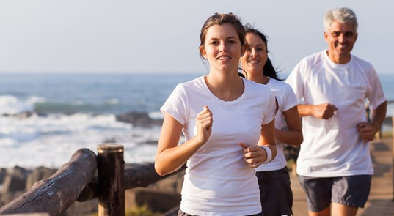
空白演示
Running into
a Better Life
单击输入您的封面副标题

Slide 2
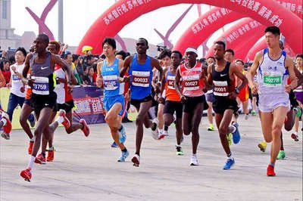
Warming up： 1. Do you like running? 2. Are you familiar with this sport?

Slide 3
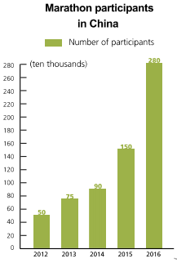
Look and think
What key information is shown in this chart?
The number of Marathon participants in China is increasing.

Slide 4
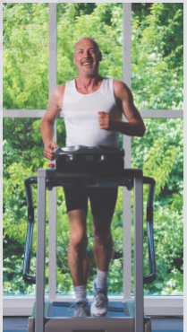
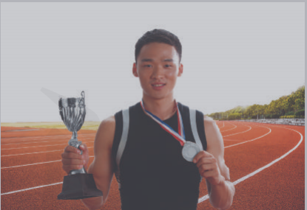
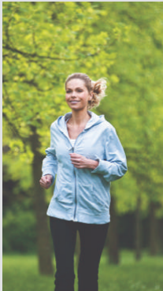
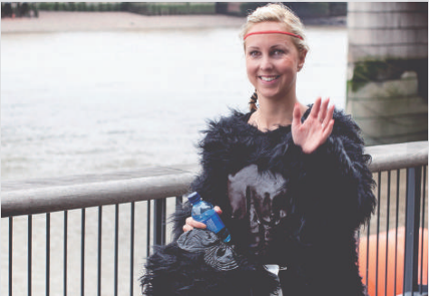
Running into a Better Life

Slide 5
What is your understanding of the title?
Running can bring a lot of benefits to us both physically and mentally. It may improve our physical conditon, bring us confidence, help us make new friends and reduce stress from work.

Slide 6
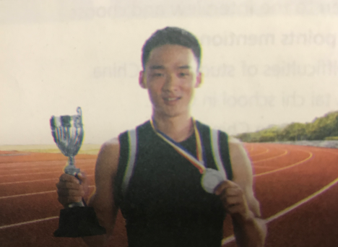
Reasons for starting running
Running could improve how his lungs work and help him treat his asthma.
Benefits gained from running
Running improved his fitness and led him to achieve things he never thought he could do.
Li Yue , 16, Beijing

Slide 7
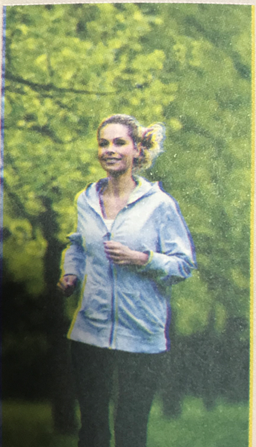
Reasons for starting running
She discovered an app that listed people`s performance and she wanted to see her name in the top five
Benefits gained from running
She came across other runners in the same area and fell in love with running.
Sarah , 36 , Montreal

Slide 8
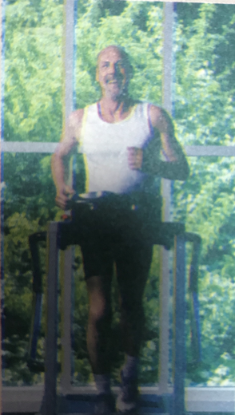
Reasons for starting running
His job sometimes is quite stressful and makes him feel anxious. To help deal with this, he started running.
Benefits gained from running
After running, all his stress disappears and he is ready to face the next day at work.
David , 52, New York

Slide 9
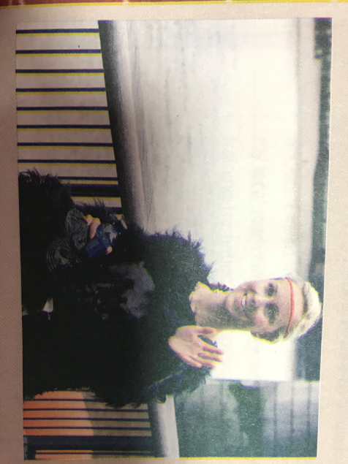
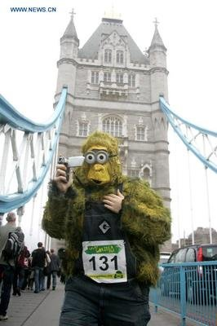
Reasons for starting running
She participated in a programme run by The Gorilla Organization to raise money.
Grace, 25, Manchester
Benefits gained from running
She had a great day in London, as well as helping to save gorillas.

Slide 10
benefits of running
1 build up strength
2 be good for our eyes
3 relieve stress
4 lose weight
5 help us make new friends
6 improve the quality of sleeping
7 improve the function of heart and lung
8 hone(磨练）one`s will and perseverance
……

Slide 11
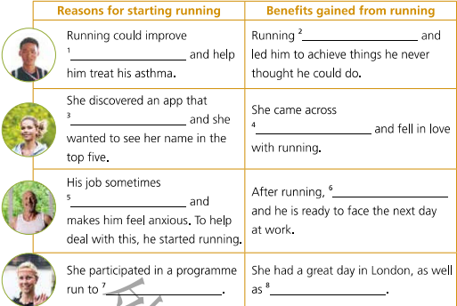

Read and complete the table
improved his fitness
how his lungs work
listed people’s performance
other runners
his stress disappears
is stressful
raise money to save the world’s last remaining gorillas from dying out
helping to save gorillas

Slide 12

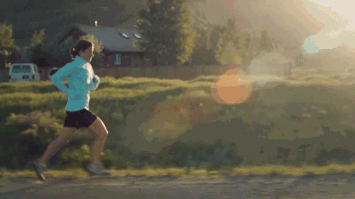
Read the text on page 32-33 again and choose the best answers.
1 From paragraph 1 , we know________.
A Li Yue was born with asthma but he dreamed of being a runner
B Li Yue joined a local athlete club to become a runner
C Li Yue won silver in the under 18`s 1000 metres
D Li Yue`s doctor thought exercise could improve the condition of his lungs.
2 At first, Sarah kept running in order to ______.
A lose weight
B be in the top five
C win the first prize
D take part in a sports meeting

Slide 13
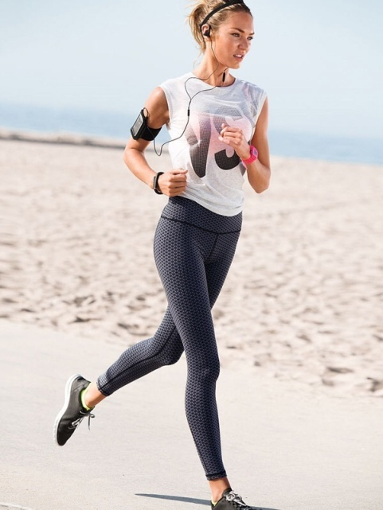

3 Who kept running to help deal with stress?
A Grace B David C Sarah D Li Yue
4 What benefit did Grace gain from running?
A She recovered from lung disease.
B She won the first place.
C She was in the top five.
D She had great fun and helped to save gorillas.
5 Of the four runners, we know_______.
A Li Yue is the youngest
B Grace used an app called Running Power
C Sarah is a computer engineer
D David was born with asthma

Slide 14
Think and share
Which of these running stories impresses you most? Why?
What can you learn from these people?
In what ways do you think apps and social media can help us do sports?
Do you know of any running events in China? Have you ever participated in any of them?

Slide 15
Li Yue joined a local athlete club 1________ exercise could improve how his lungs work. As his 2________(fit) and running improved, he started running in 3___________(nation) competitions. Sarah discovered an app 4______(call) Running Power. At first, she kept running just 5______(see) her name in the app top five. But now she 6_______(fall) in love with running. For David, 7___computer engineer, there`s always a new challenge, so he goes running to reduce his stress. Grace entered the Great Gorilla Run in London, 8________ is run by the Gorilla Organization to raise money to save the world`s gorillas from 9_________(die) out. After the run, 10_______ she was sweaty and tired, she had a great day.
because
fitness
national
called
to see
has fallen
a
which
dying
though/
although

Slide 16
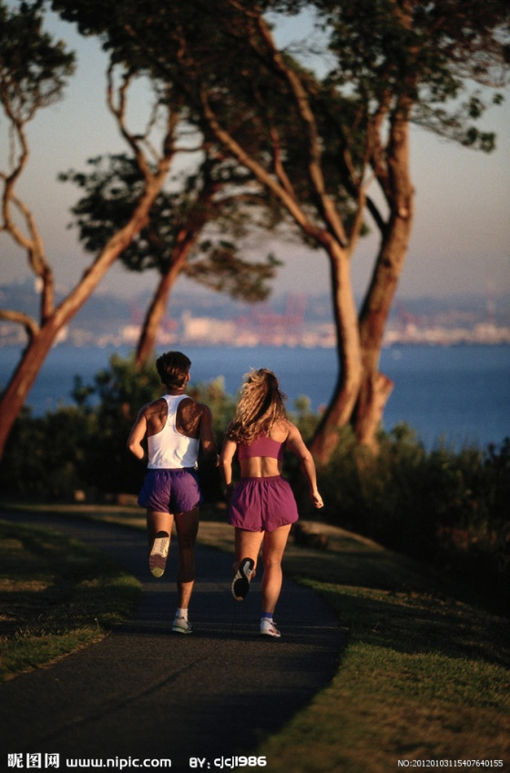
Running can bring a
lot of benefits to us, both physically and mentally. It may improve our physical condition, bring us confidence, help us make new friends and reduce stress from work.

